Slide 1



Slide 2

There is a difference between hearing and listening. Listening, as opposed to hearing, has been highlighted as one of the most important communication skills for employees.
A 1999 survey found that 80 per cent of a sample of American executives rated listening as the most important skill in the workforce, far above technical skills yet 28 per cent of the same sample thought listening skills were also the most lacking in the workforce.
Researchers at the University of Minnesota concluded that nearly 60 per cent of misunderstanding in the business world could be traced to poor listening, and only 1 per cent to written communication.
Research conducted in the Singapore insurance industry showed that the more experienced staff members were, the more likely they were to value listening above speaking as a communication strategy; the more inexperienced staff members were, the more likely they were to interrupt and thus annoy customers.

Slide 3


Slide 4
The following table highlights the key differences between hearing and listening.
Hearing | Listening
Accidental Involuntary Effortless | Focused Voluntary Intentional

Slide 5

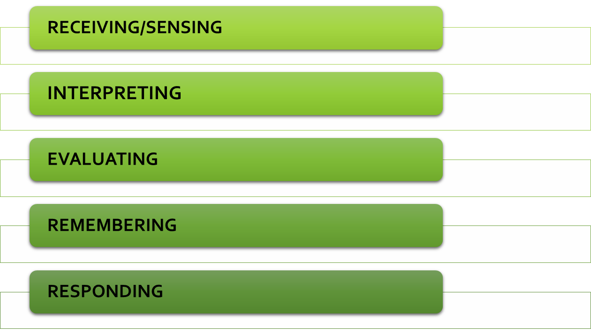

Slide 6




Slide 7

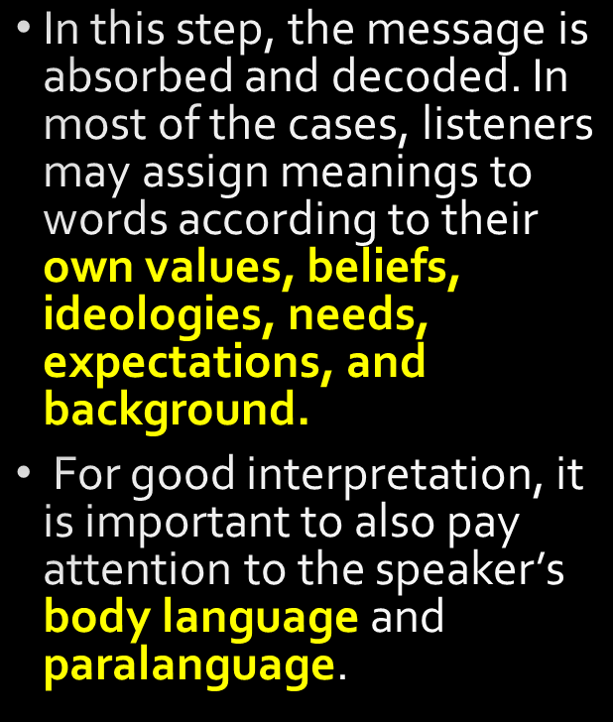


Slide 8
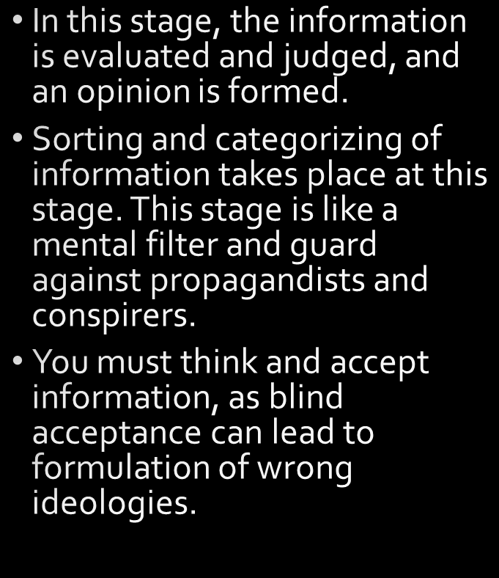


Slide 9




Slide 10

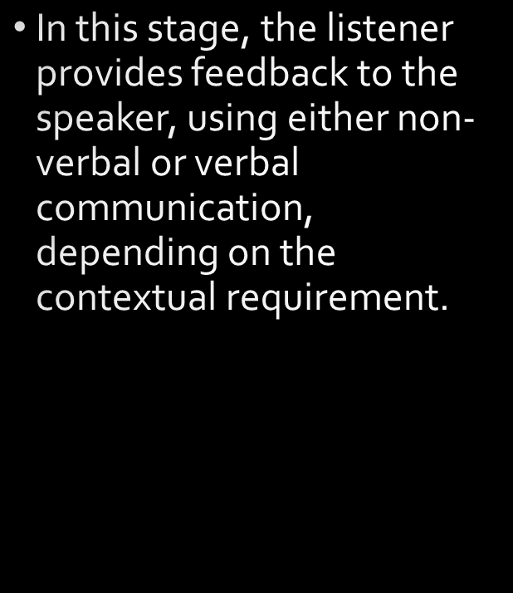
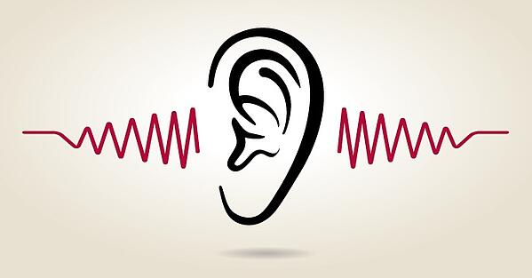

Slide 11
Boredom or lack of interest
Dislike of speaker’s personality or physical appearance
A desire to change rather than accept the speaker
A tendency to make early conclusions or listening only for pauses to interrupt the speaker
Perception that the speaker lacks credibility
Being distracted by the environment
Rushing the speaker to complete speaking

Slide 12
OVERCOMING BARRIERS
As an active listener, you remove all judgment about the other person’s situation.
You do not give them any advice or your opinion – you just simply listen.
Do not do the talking – allow the other person to talk.

Slide 13

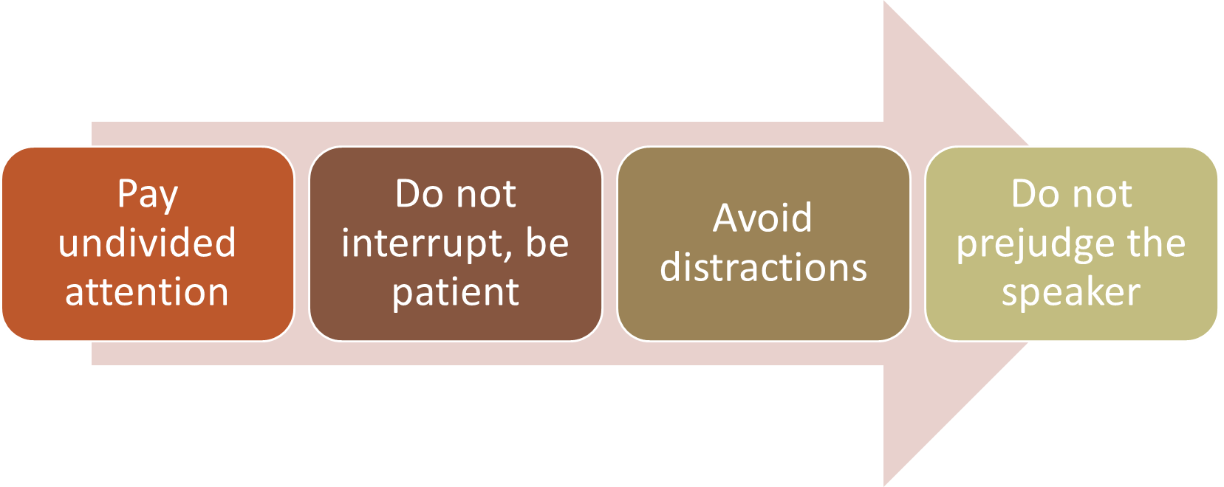

Slide 14
Using active listening allows you to:
Check the accuracy of what the speaker has said
Check the feelings of the speaker
Summarize what the speaker has said
Acknowledge what the speaker has said, without making any kind of commitment
Open a door, prompting the speaker to continue

Slide 15
Effective Questions
Open questions invite the other person to talk
Closed questions invite the other person to give a ‘yes’ or ‘no’ response
Probing questions to gain more details
Mirror questions to show interest in what the other person has said

Slide 16
Ineffective Questions
Multiple questions that cover a number of issues
Leading questions to get the answer you want
Implied value questions that reflect your values
Ambiguous or vague questions that confuse

Slide 17
Types of Active Listening Skills

Slide 18
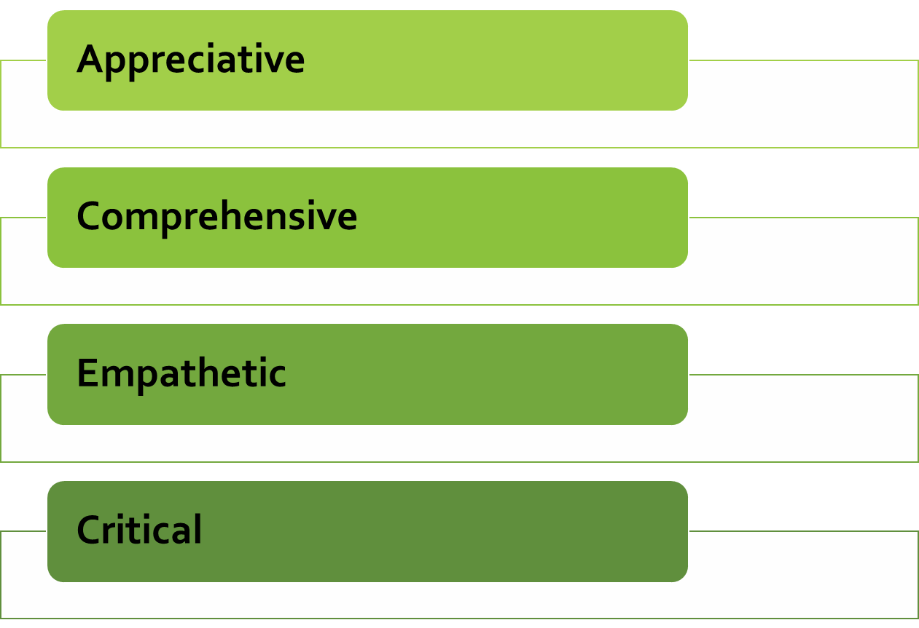

Slide 19
Appreciative Listening
Your goal is to simply enjoy the thoughts and experiences of others by listening to what they are saying.
With appreciative listening, you do not have to focus as closely or as carefully on specifics as you do in other listening situations.
You might use appreciative listening during a casual social conversation while watching a ball game with friends or when listening to any kid describe the fish s/he caught on an outing with her/his grandpa.

Slide 20
Comprehensive Listening
In a comprehensive listening situation, your goal is not only to understand the speaker’s message but also to learn, remember, and be able to recall what has been said.
We listen comprehensively to professors lecturing about key concepts, speakers at training seminars, and broadcast news reports that provide timely information about traffic conditions.

Slide 21
Empathetic Listening
When the situation calls for us to try to understand how someone else is feeling about what they have experienced or are talking about, we use empathic listening.
Therapists, counselors, psychologists, and psychiatrists engage in empathic listening with their clients.

Slide 22
Critical Listening
Your ultimate goal is to evaluate the worth of a message. Because you need to hear, understand, evaluate, and assign worth to the message, it requires more psychological processing than the other types.
Critical listening is the most demanding of the types of listening because it requires that you understand and remember both the verbal and nonverbal message, assess the speaker’s credibility, and effectively analyze the truthfulness of the message.

